Slide 1

CIS 556 Fall Project - Jewelry Biz
Team Data Scientists
Jasvir Singh, Renjith Nair, Sukriti Singh, Mayura Talekar, Steven Belanger
Notes:
Sukriti

Slide 2
Project Introduction
NEED:
Creating a Standard Website for Jewellery Business containing - Main Page, Contact Us information, Search Ability etc.
Ability for customers to create an account and sign up for emails or also to continue shopping as a guest.
Everyday Jewellery like - Necklaces, Bracelets, Earrings present on website for adding to cart.
Functionality of Shopping cart and checkout.
Generation of Monthly/Yearly reports of - sales, inventory levels and inventory costs, customer lists.
TASKS:
Create the Standard Website with required functionalities.
Create complete and build ERDs of the enterprise.
Modelling and designing of database.
Building and Testing of the imported test data.
Notes:
Sukriti

Slide 3

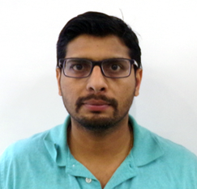
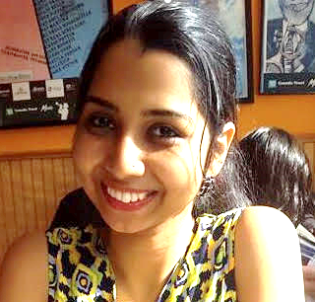
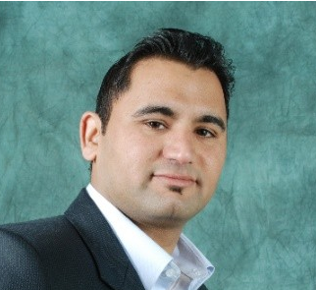
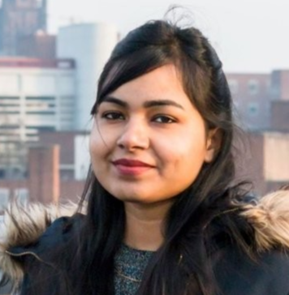

Renjith Nair
Mayura Talekar
Jasvir Singh
Sukriti Singh
Steven Belanger
Notes:
Sukriti

Slide 4
Team Skills Sets
Application development using Microsoft .Net Technologies( C#, ASP.NET, MVC, ADO.Net), Visual Studio 2017, Ajax, Javascript, jQuery, HTML, CSS, SQL Server
Database design (tables, constraints, relations) & data manipulation(Stored procedures)
Active participation in ERD Development
Prepared Test data scripts to feed master data into master tables
Performed application testing and prepared final build
Jasvir Singh
ERD development, Business Modelling, SQL Stored Procedures, Database Design, Master Data creation, Project Planning and Coordination
Renjith Nair
Served as Team-Lead of this project group arranging all of the sync meetings
Prepared the project plan and timely updation of the same
Prepared the Complete and Build ERD
Provided inputs for database designing
Sent out weekly status updates to Professor on behalf of the Team
Participated in Business Logic part of the project
Sukriti Singh
Created Data dictionary and mock data
Provided input designing ERD and database
Contributed for application development.
Active participation in team meeting and discussions
Mayura Talekar
Consistent participation, team coordination, meeting scheduling, and collaboration
Contributed to ERD efforts as well as provided input on system and database design
Contributed to project documentation, organization, and submission
Steven Belanger
Notes:
Sukriti

Slide 5
Technology Stack
Microsoft Visual Studio 2017
MVC (Model View Controller) design pattern
C#
LINQ(Language Integrated Query) to filter/manipulate data retrieved from database
ADO.Net
jQuery
CSS for styling the User Interface
HTML
SQL Server as database management tool, PL-SQL for data manipulation
Git as central code and database repository tool
Web Server : IIS(Internet Information Services)
Application is in 3 layer architecture.
Application security is cookie based.
Source code link: https://github.com/jasvirsingh/jewelrybiz-v1
Notes:
Steve

Slide 6
Additional Functionality Added
Ability to view purchase history by customer
Customer can view account and/or profile information
Basic application security
Notes:
Steve

Slide 7
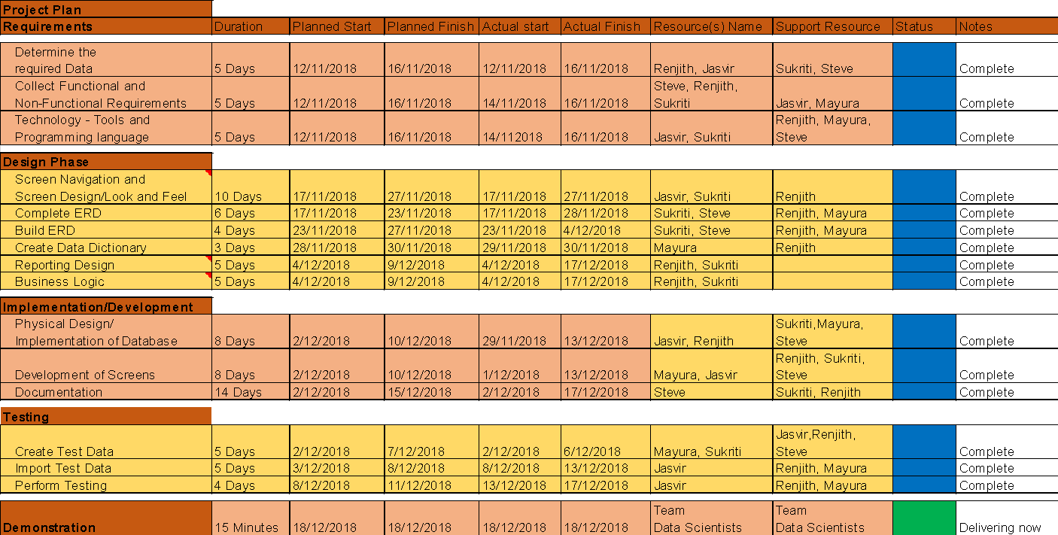
Project Status – Completed Successfully
As depicted in below project plan, we were able to complete all major deliverables prior to the presentation we are delivering today
We did deviate from planned finish dates but due mainly to flow of work and not lack of effort.
Notes:
Renjith

Slide 8
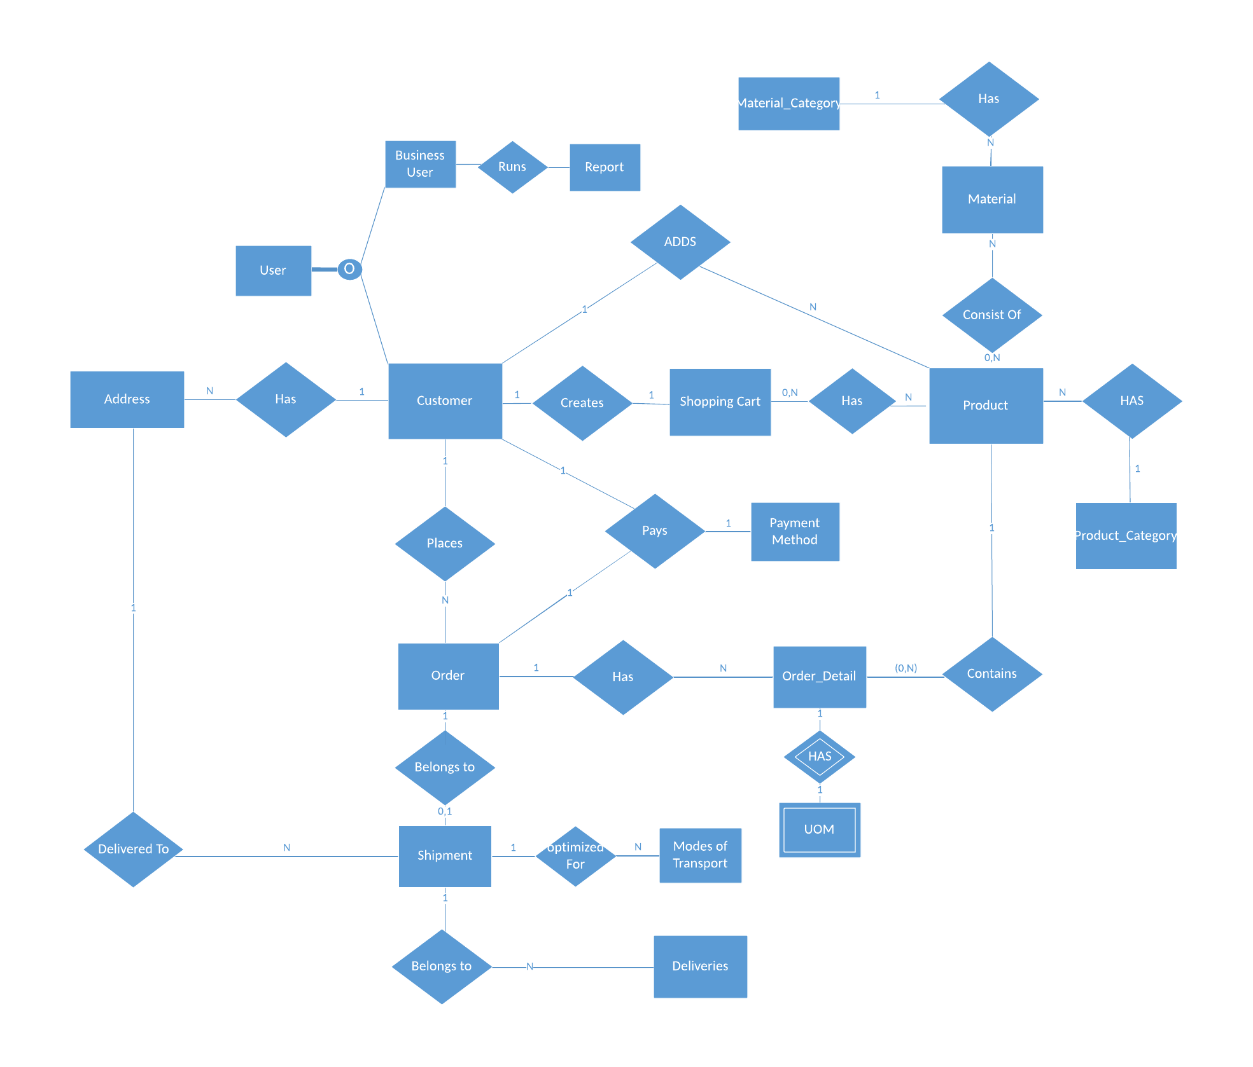
Complete ERD
Notes:
Renjith

Slide 9
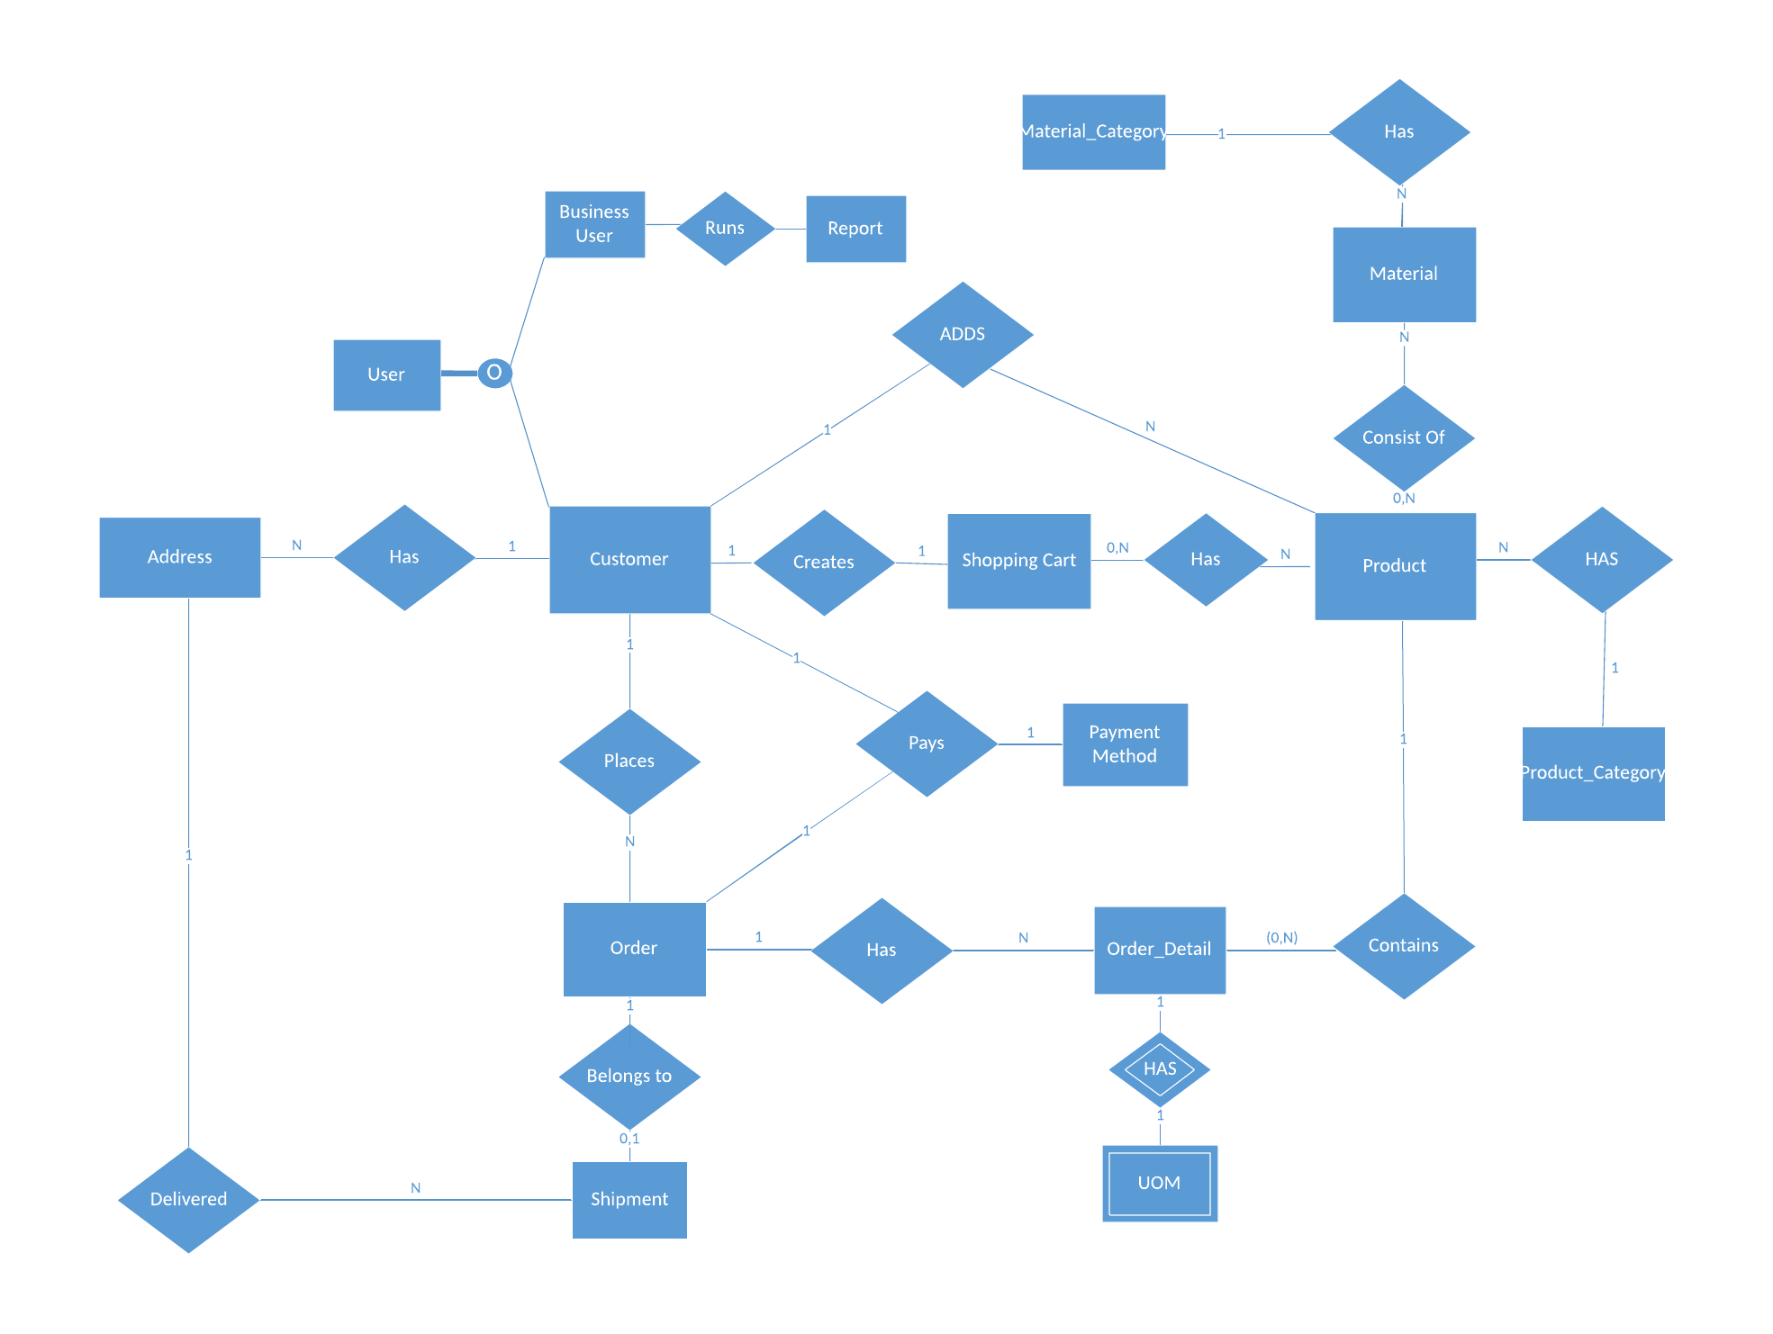
Build
ERD
Notes:
Renjith

Slide 10
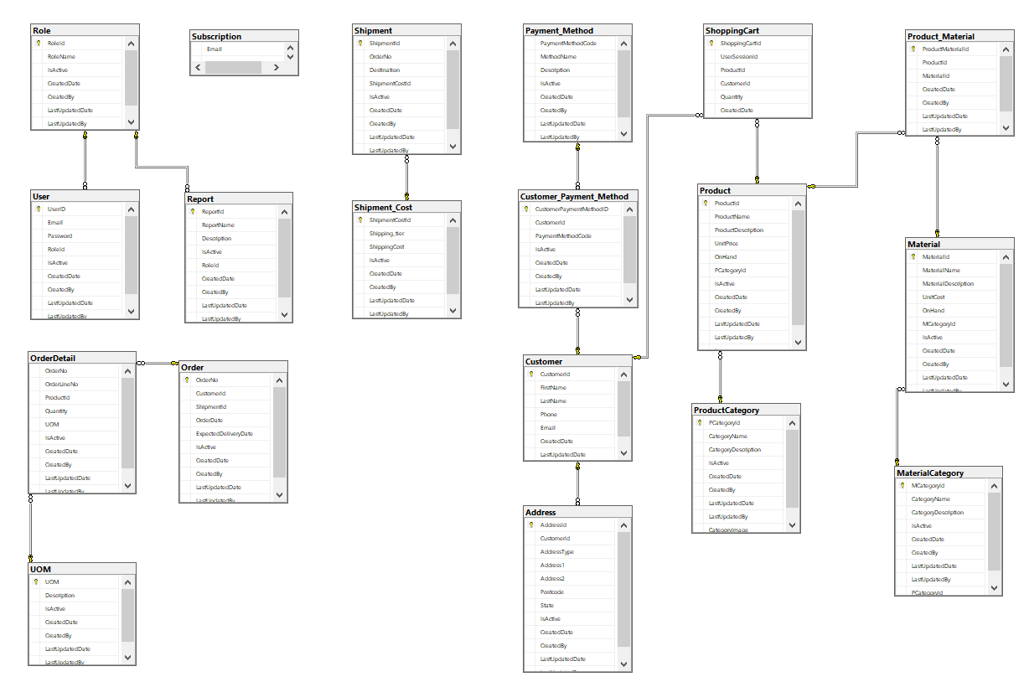
Database Diagram
Notes:
Renjith

Slide 11
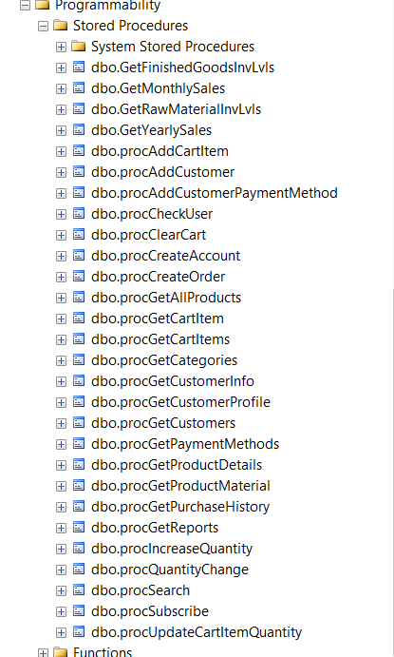
List of stored procedures created

Slide 12
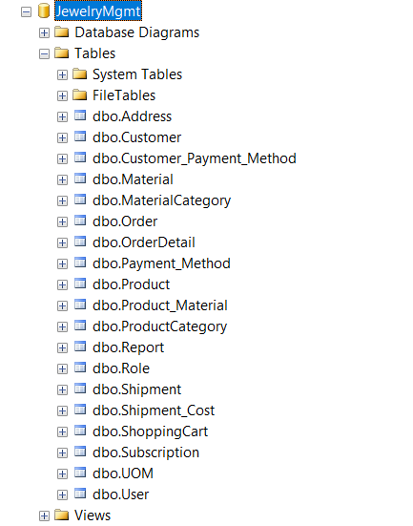
List of database tables

Slide 13
AND NOW FOR OUR DEMONSTRATION…

Slide 14
Wins, Obstacles, and Lessons Learned
Wins
Being able to leverage prior programing/project work
Having expert software developers in the group
Obstacles
Having a lot of work to complete in a short time frame
Lessons Learned
Having a strong project team greatly increases opportunity for success
If you had to do it all again…
Please don’t make us redo this project. ☺ We feel great about what we did this time around.
Notes:
Jasvir

Slide 15
Application Functionalities
Create Account/Sign-up
Login
Logout
Products Search
Email Subscription
Product Categories list
Products list based on selected category
Product detail
Add To Cart
Checkout
Shopping Bag
Shipping details
Purchase History
Account Info & Payment details
Admin can generate Reports except Mailing labels report
About Us
Contact Us

Slide 16
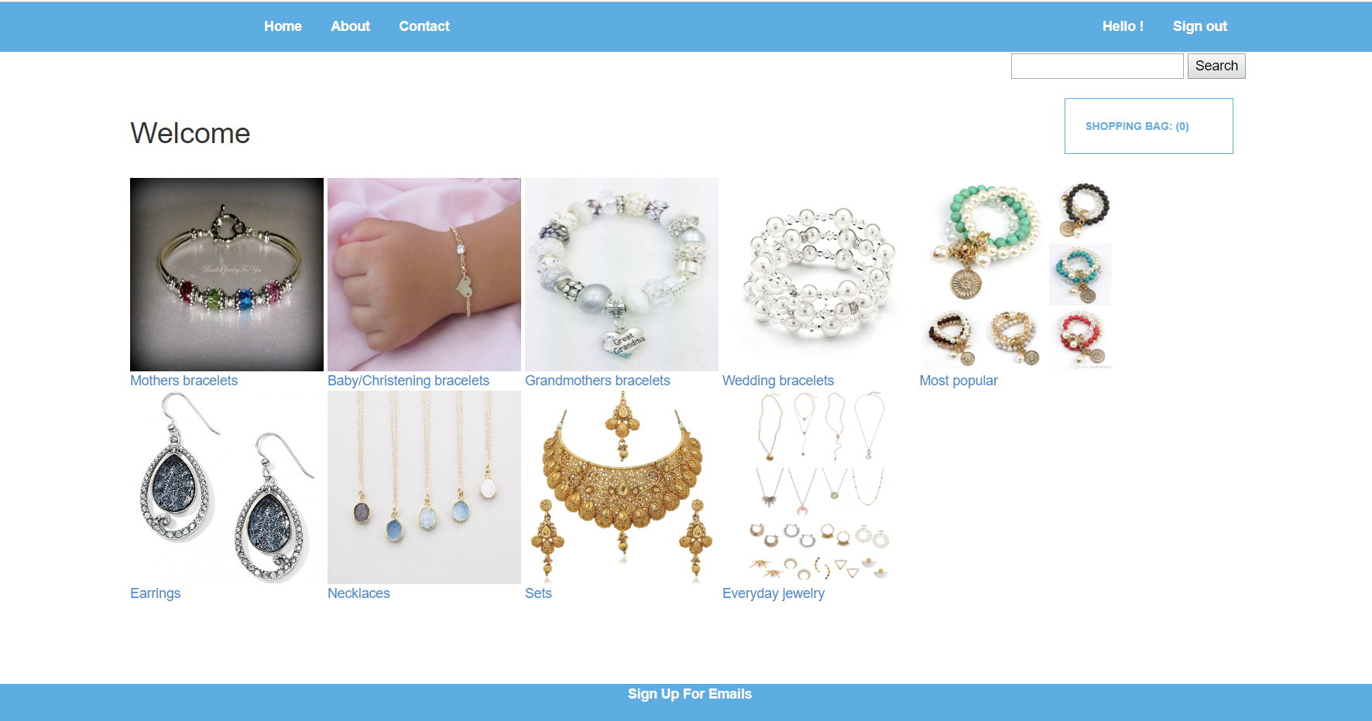
Home Page

Slide 17
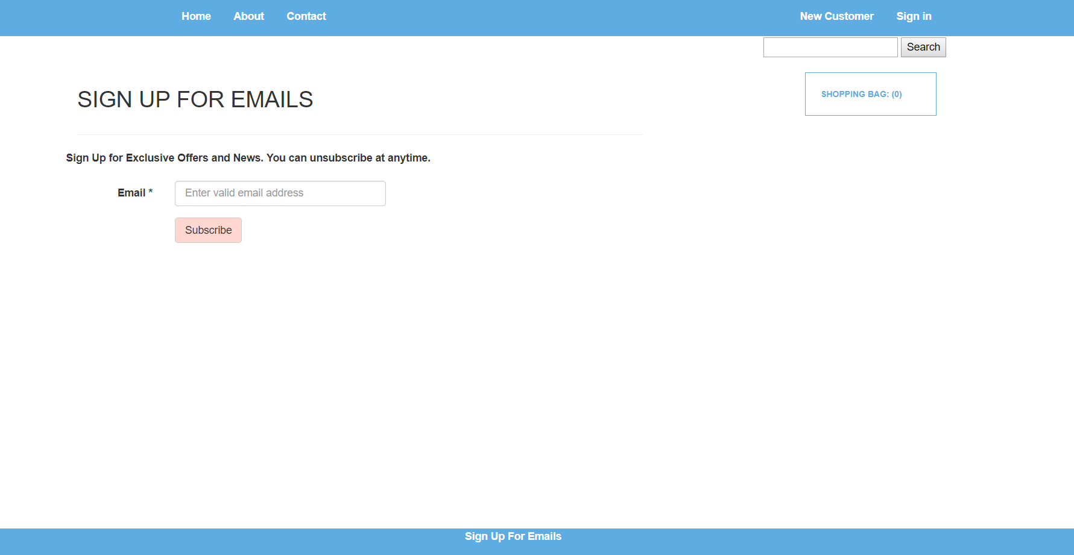
Sign-up for Emails

Slide 18
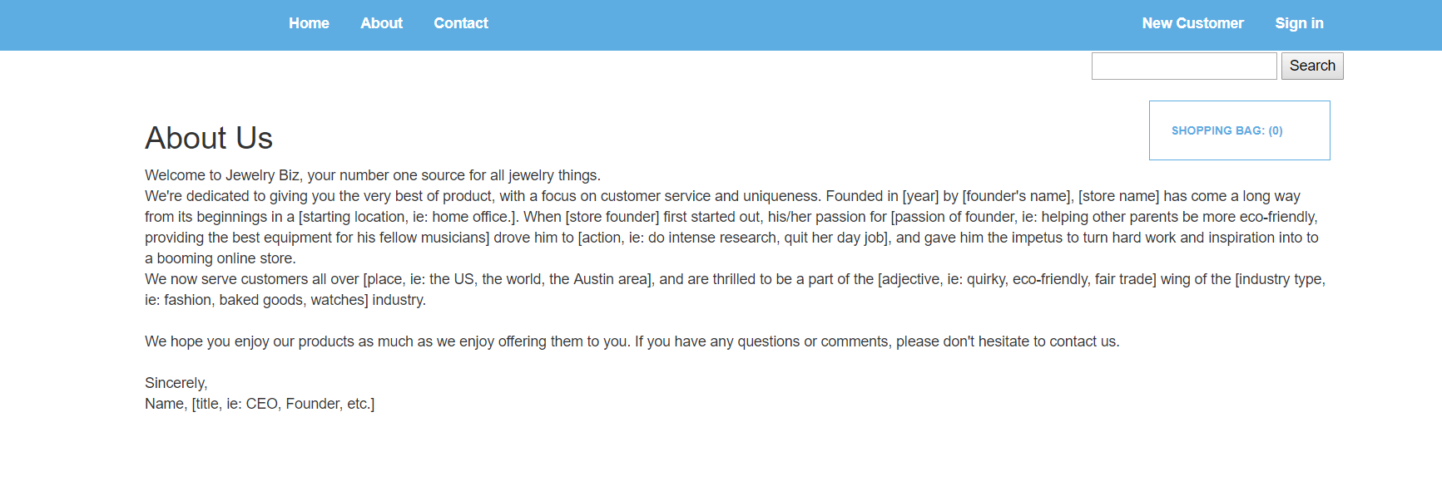
About Us

Slide 19
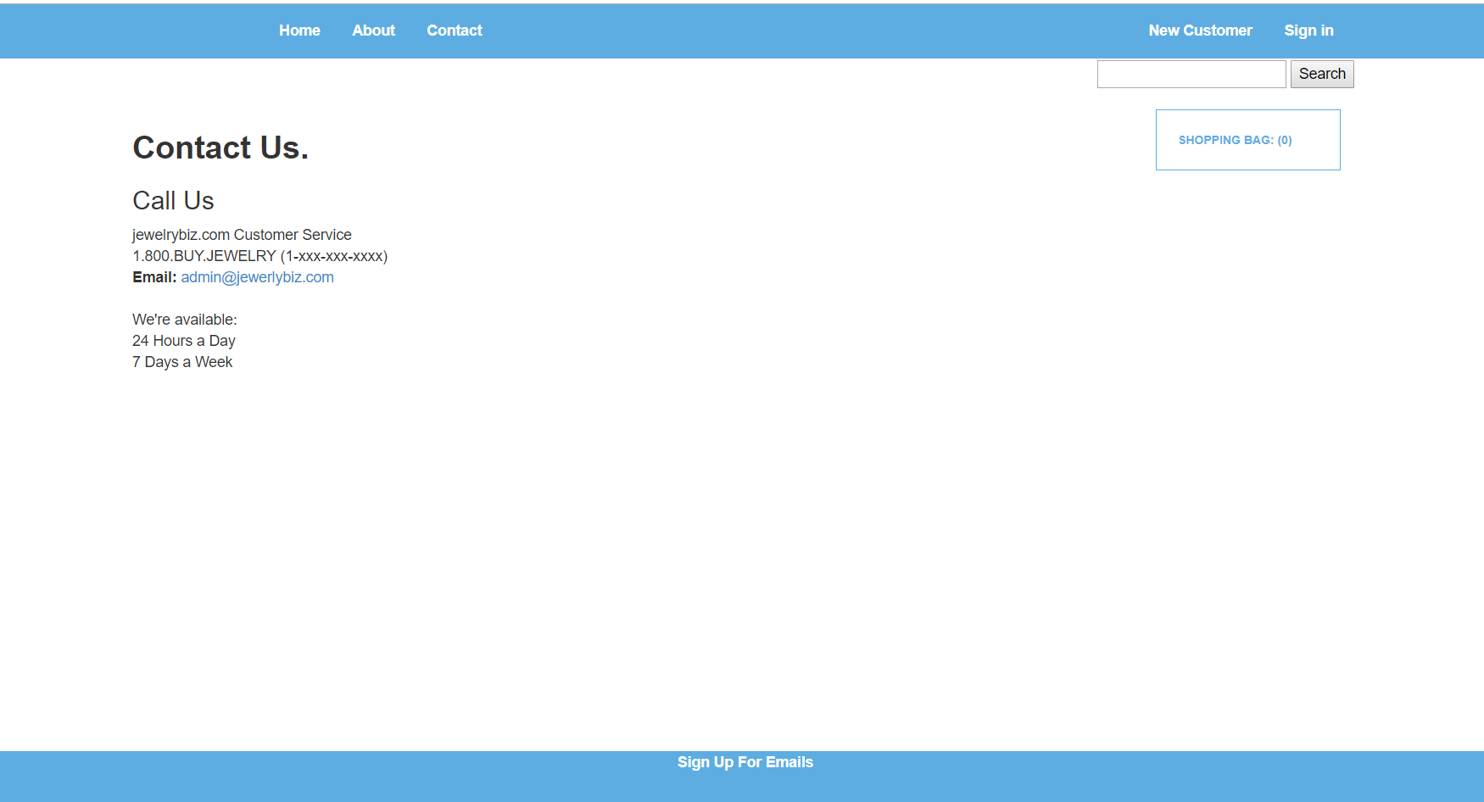
Contact Us

Slide 20
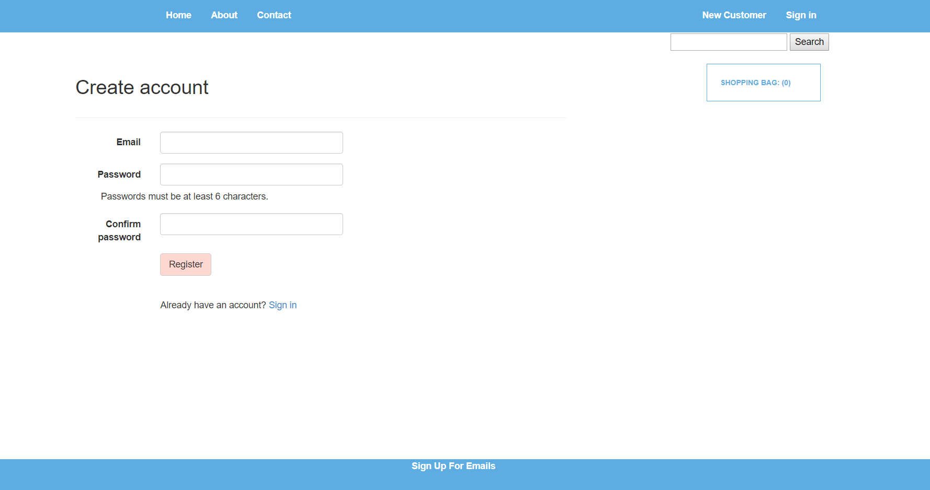
Create Account

Slide 21
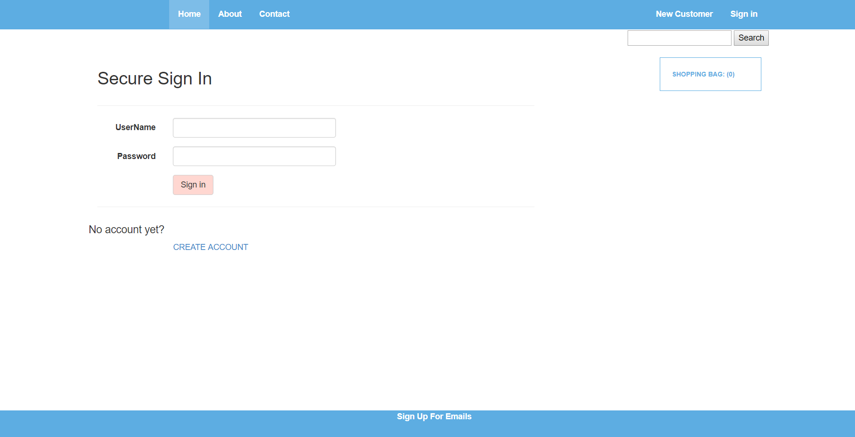
Sign In

Slide 22
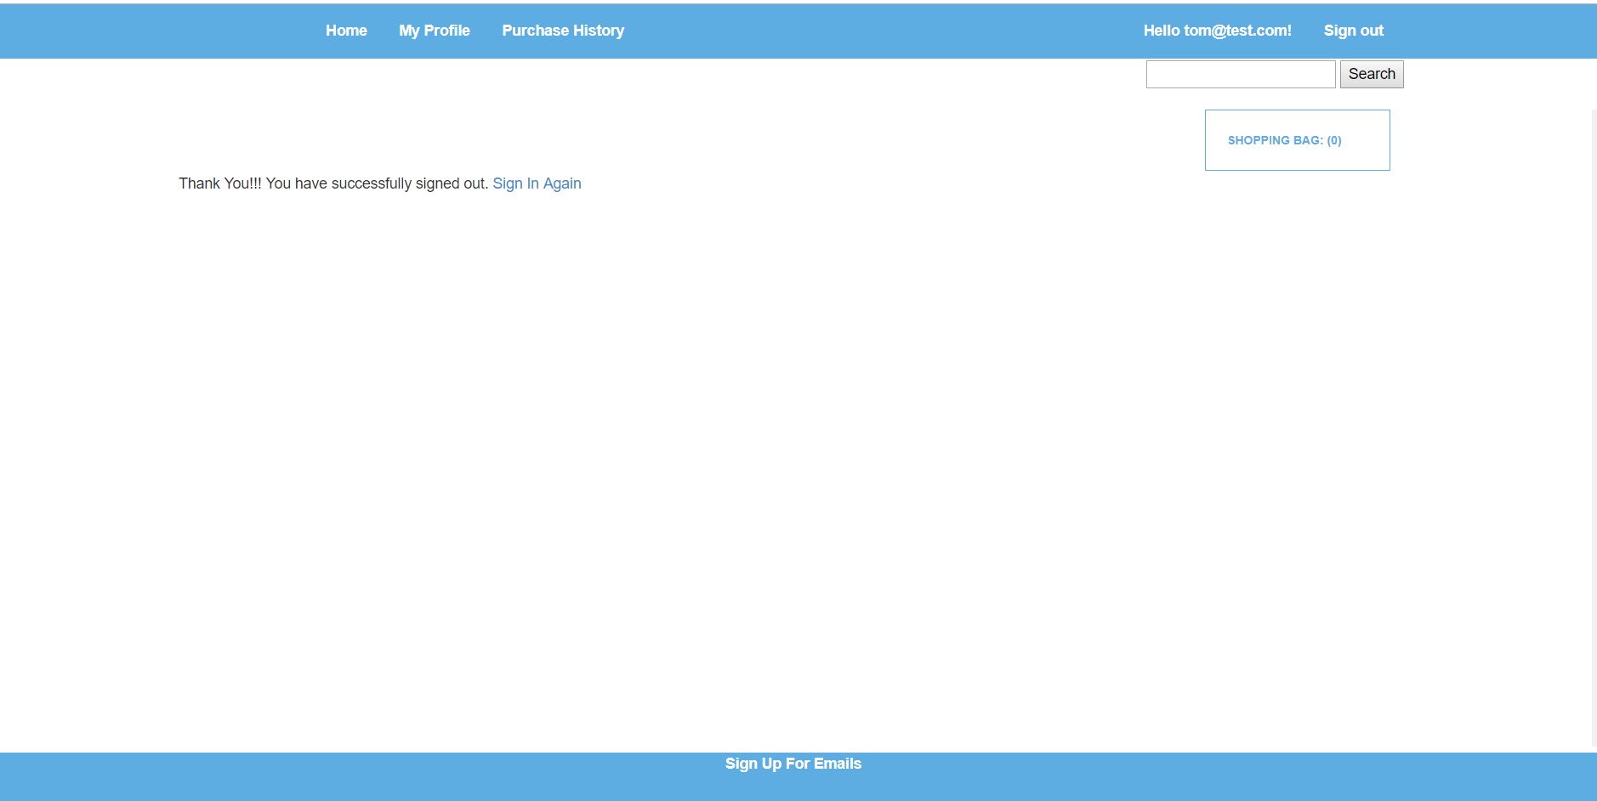
Sign out

Slide 23
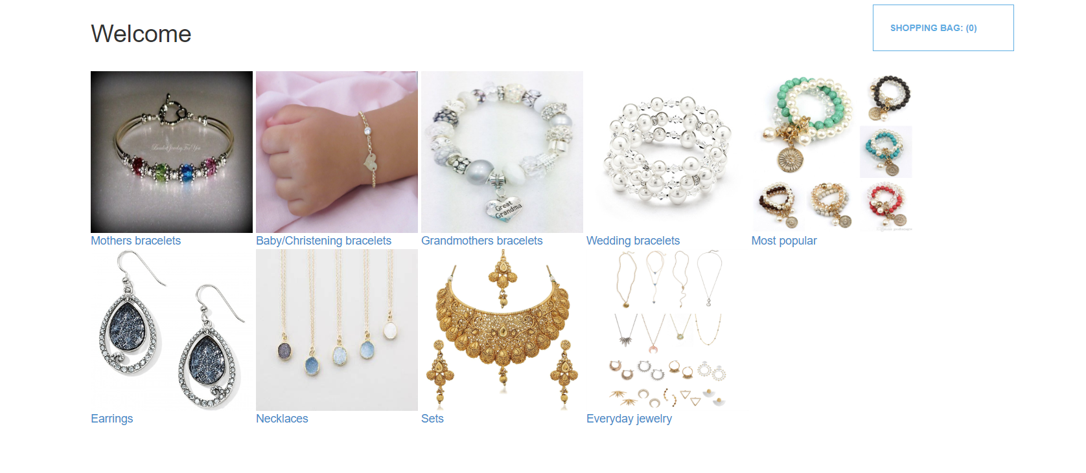
Categories List

Slide 24
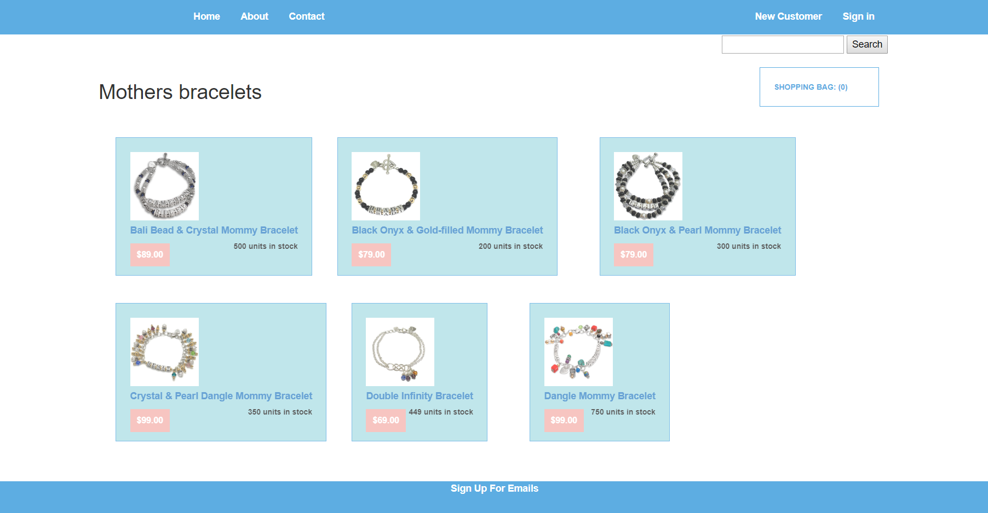
Products List

Slide 25
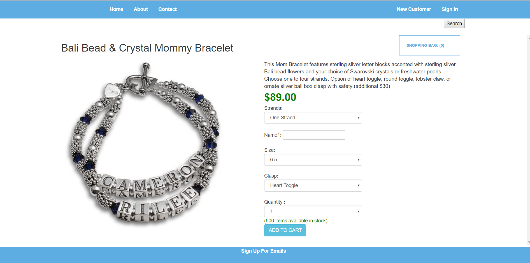
Product details

Slide 26
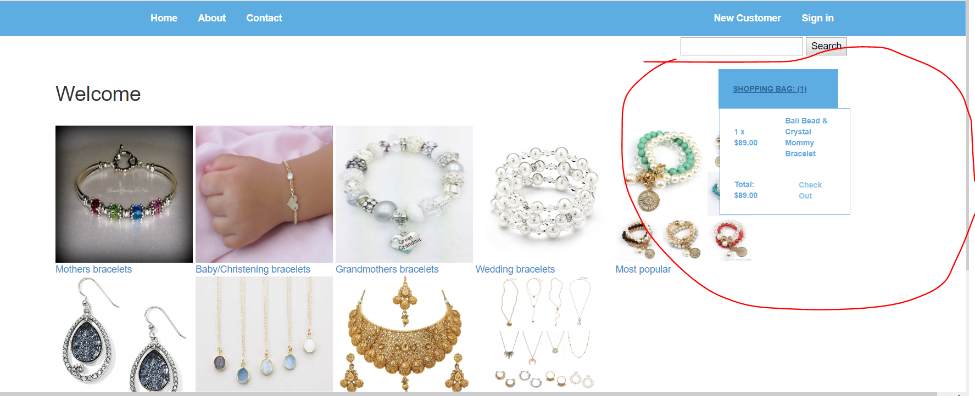
Shopping Bag display

Slide 27
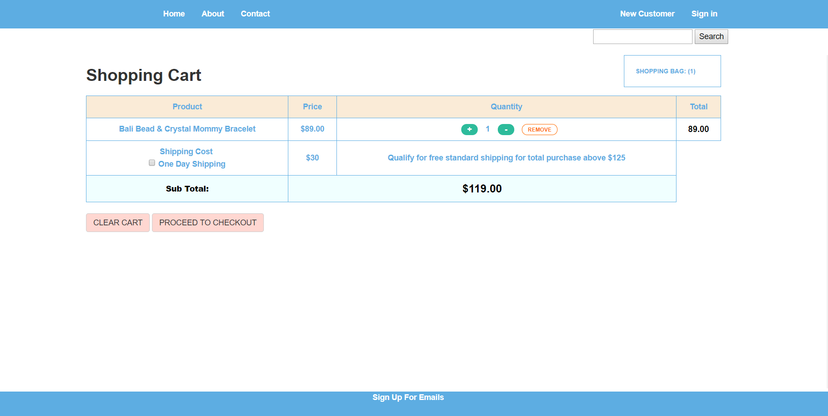
Shopping Cart display

Slide 28
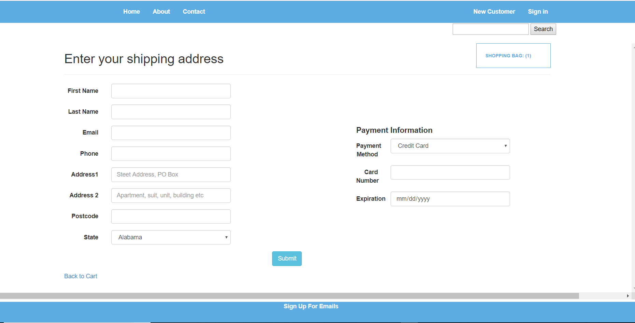
Enter shipping & payment info

Slide 29
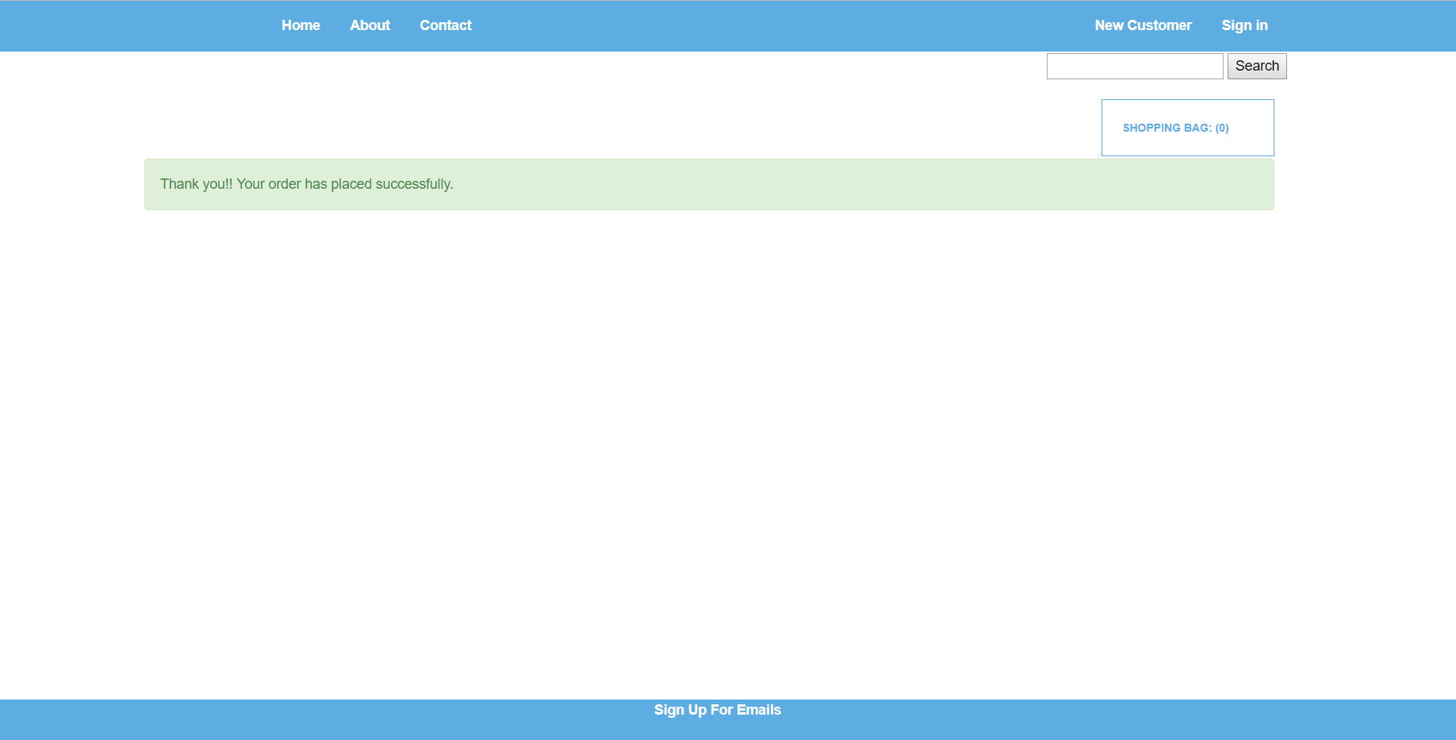
Order confirmation

Slide 30
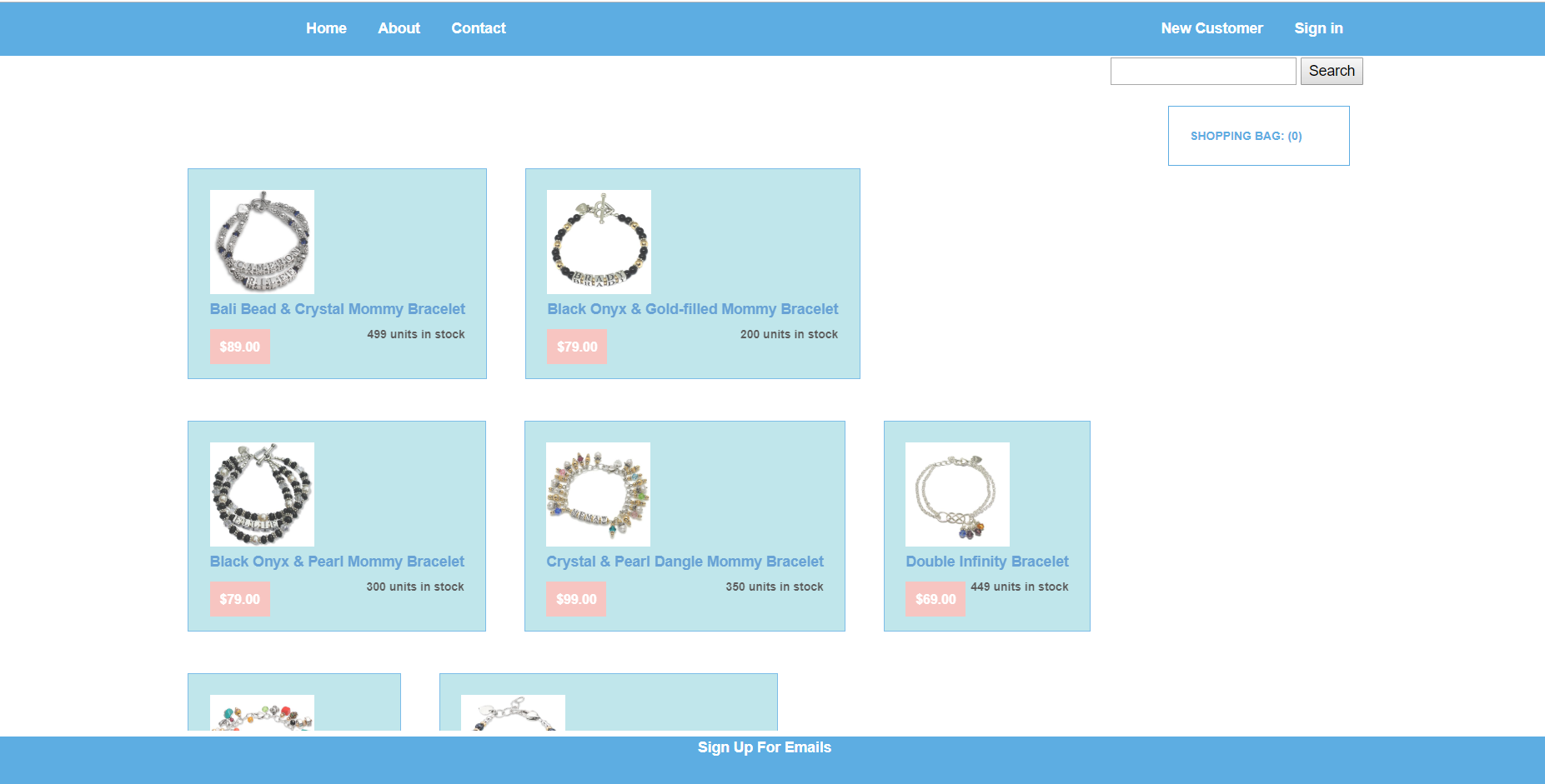
Search Results

Slide 31
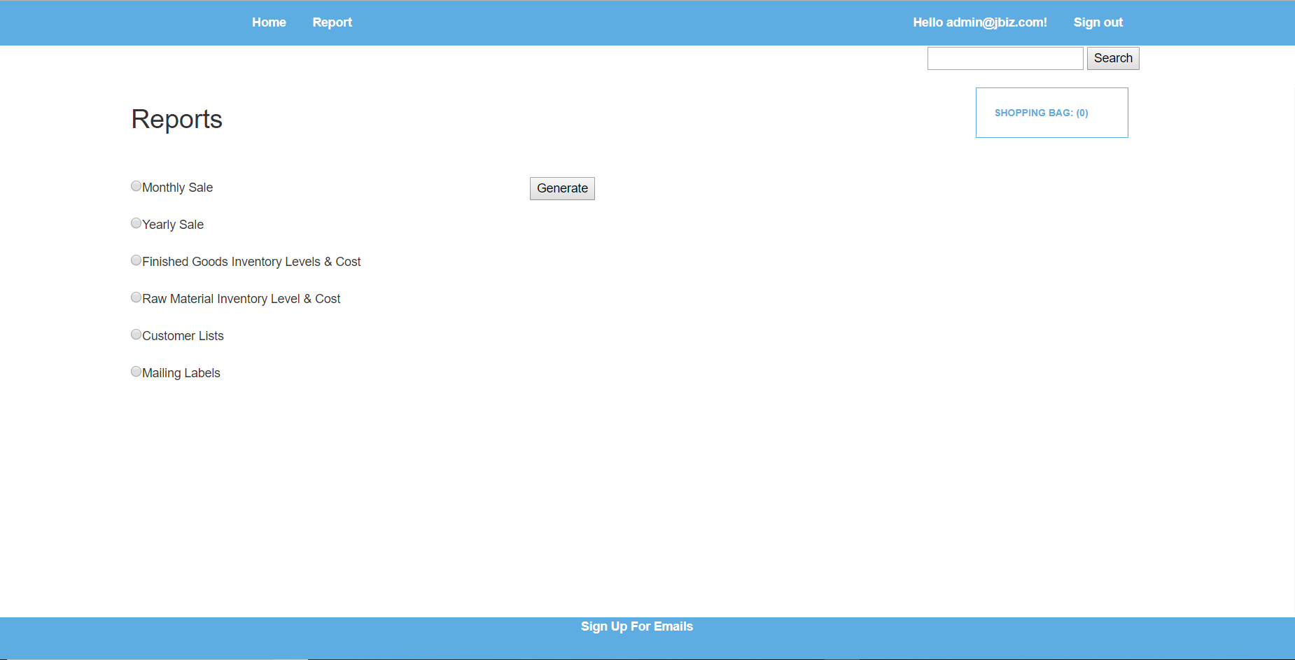
Reports

Slide 32
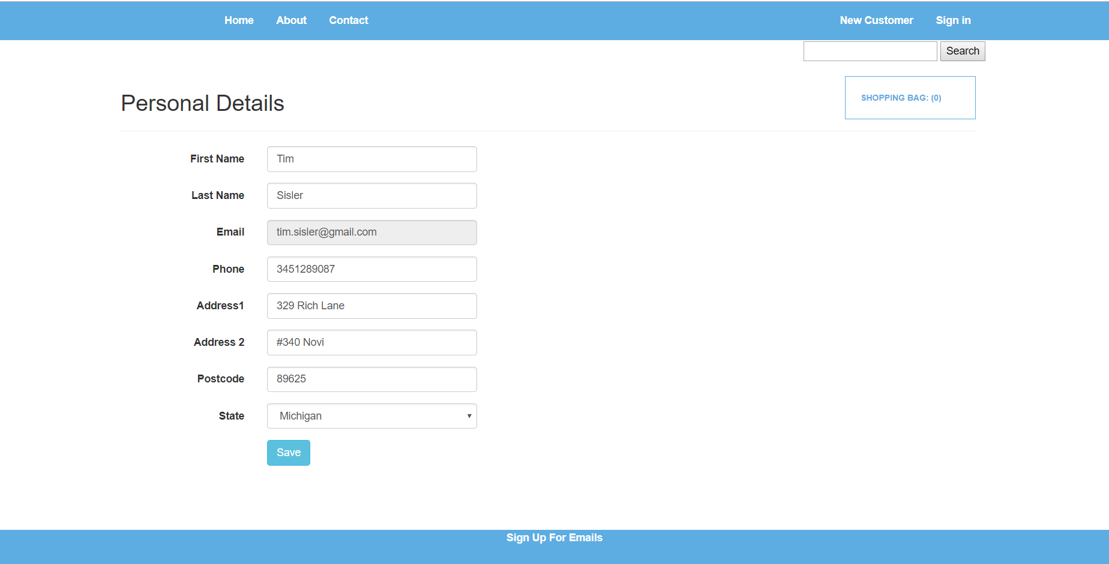
Customer Personal details

Slide 33
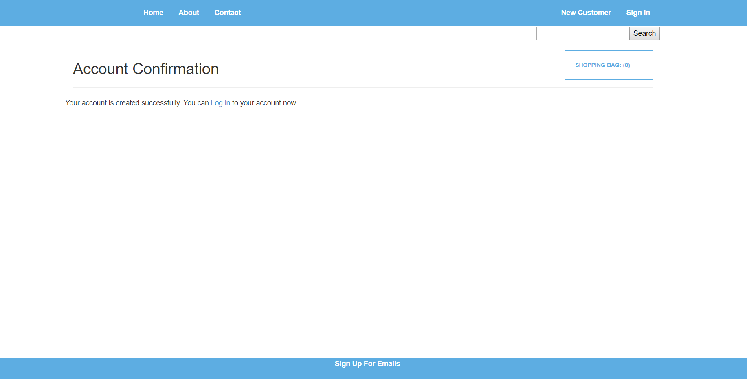
Customer Account Confirmation

Slide 34
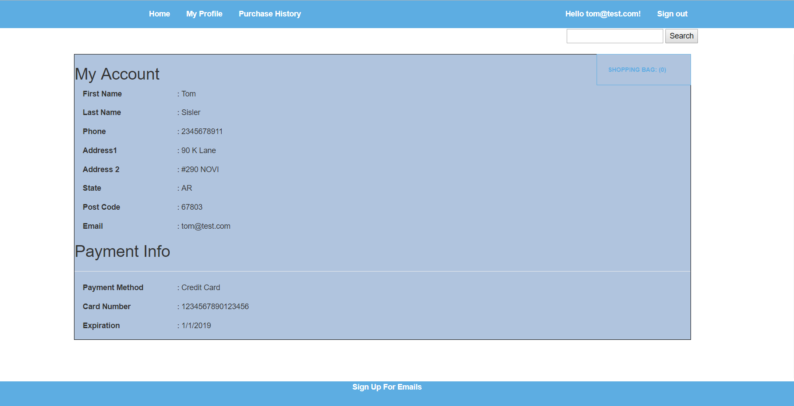
Customer Account Info

Slide 35
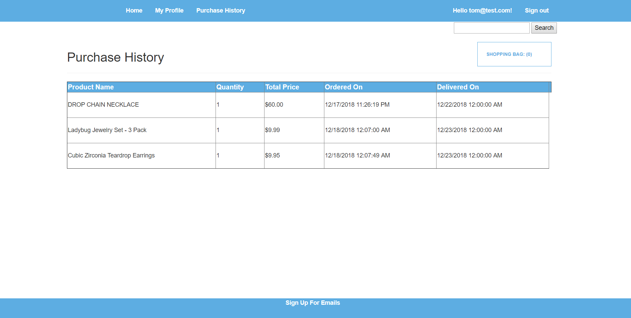
Purchase History

